Slide 1
William Stallings Data and Computer Communications 7th Edition
Chapter 17 Wireless LANs

Slide 2
Overview
A wireless LAN uses wireless transmission medium
Used to have high prices, low data rates, occupational safety concerns, and licensing requirements
Problems have been addressed
Popularity of wireless LANs has grown rapidly

Slide 3
Applications - LAN Extension
Saves installation of LAN cabling
Eases relocation and other modifications to network structure
However, increasing reliance on twisted pair cabling for LANs
Most older buildings already wired with Cat 3 cable
Newer buildings are prewired with Cat 5
Wireless LAN to replace wired LANs has not happened
In some environments, role for the wireless LAN
Buildings with large open areas
Manufacturing plants, stock exchange trading floors, warehouses
Historical buildings
Small offices where wired LANs not economical
May also have wired LAN
Servers and stationary workstations

Slide 4
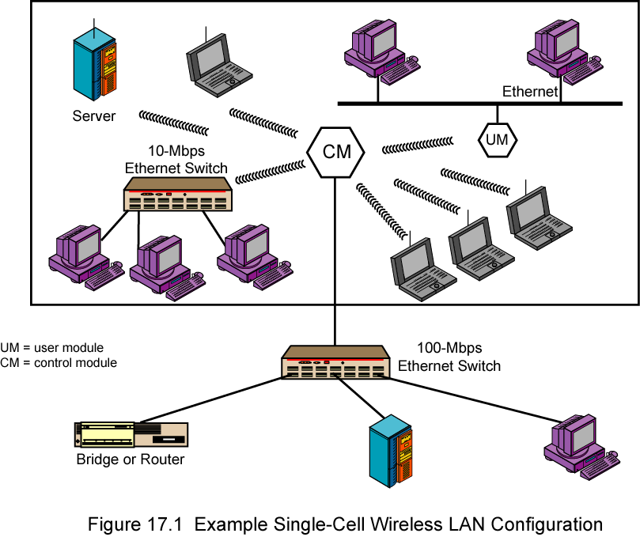
Single Cell Wireless LAN Configuration

Slide 5
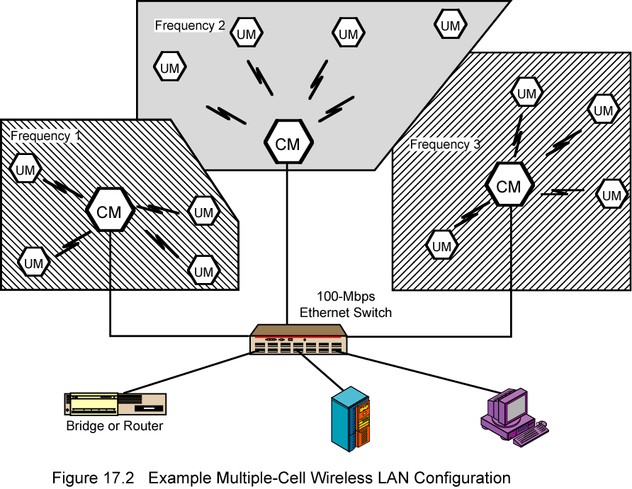
Multi-Cell Wireless LAN Configuration

Slide 6
Applications – Cross-Building Interconnect
Connect LANs in nearby buildings
Point-to-point wireless link
Connect bridges or routers
Not a LAN per se
Usual to include this application under heading of wireless LAN

Slide 7
Applications - Nomadic Access
Link between LAN hub and mobile data terminal
Laptop or notepad computer
Enable employee returning from trip to transfer data from portable computer to server
Also useful in extended environment such as campus or cluster of buildings
Users move around with portable computers
May wish access to servers on wired LAN

Slide 8
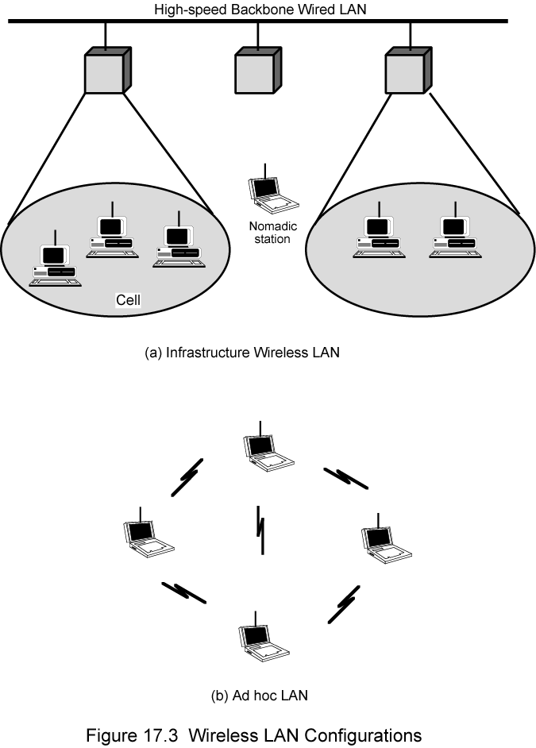
Infrastructure Wireless LAN

Slide 9
Applications – Ad Hoc Networking
Peer-to-peer network
Set up temporarily to meet some immediate need
E.g. group of employees, each with laptop or palmtop, in business or classroom meeting
Network for duration of meeting

Slide 10
Add Hoc LAN

Slide 11
Wireless LAN Requirements
Same as any LAN
High capacity, short distances, full connectivity, broadcast capability
Throughput: efficient use wireless medium
Number of nodes:Hundreds of nodes across multiple cells
Connection to backbone LAN: Use control modules to connect to both types of LANs
Service area: 100 to 300 m
Low power consumption:Need long battery life on mobile stations
Mustn't require nodes to monitor access points or frequent handshakes
Transmission robustness and security:Interference prone and easily eavesdropped
Collocated network operation:Two or more wireless LANs in same area
License-free operation
Handoff/roaming: Move from one cell to another
Dynamic configuration: Addition, deletion, and relocation of end systems without disruption to users

Slide 12
Technology
Infrared (IR) LANs: Individual cell of IR LAN limited to single room
IR light does not penetrate opaque walls
Spread spectrum LANs: Mostly operate in ISM (industrial, scientific, and medical) bands
No Federal Communications Commission (FCC) licensing is required in USA
Narrowband microwave: Microwave frequencies but not use spread spectrum
Some require FCC licensing

Slide 13
Infrared LANs Strengths and Weaknesses
Spectrum virtually unlimited
Infrared spectrum is unregulated worldwide
Extremely high data rates
Infrared shares some properties of visible light
Diffusely reflected by light-colored objects
Use ceiling reflection to cover entire room
Does not penetrate walls or other opaque objects
More easily secured against eavesdropping than microwave
Separate installation in every room without interference
Inexpensive and simple
Uses intensity modulation, so receivers need to detect only amplitude
Background radiation
Sunlight, indoor lighting
Noise, requiring higher power and limiting range
Power limited by concerns of eye safety and power consumption

Slide 14
Infrared LANs Transmission Techniques
Directed-beam IR
Point-to-point links
Range depends on power and focusing
Can be kilometers
Used for building interconnect within line of sight
Indoor use to set up token ring LAN
IR transceivers positioned so that data circulate in ring
Omnidirectional
Single base station within line of sight of all other stations
Typically, mounted on ceiling
Acts as a multiport repeater
Other transceivers use directional beam aimed at ceiling unit
Diffused configuration
Transmitters are focused and aimed at diffusely reflecting ceiling

Slide 15
Spread Spectrum LANs Hub Configuration
Usually use multiple-cell arrangement
Adjacent cells use different center frequencies
Hub is typically mounted on ceiling
Connected to wired LAN
Connect to stations attached to wired LAN and in other cells
May also control access
IEEE 802.11 point coordination function
May also act as multiport repeater
Stations transmit to hub and receive from hub
Stations may broadcast using an omnidirectional antenna
Logical bus configuration
Hub may do automatic handoff
Weakening signal, hand off

Slide 16
Spread Spectrum LANs Peer-to-Peer Configuration
No hub
MAC algorithm such as CSMA used to control access
Ad hoc LANs

Slide 17
Spread Spectrum LANs Transmission Issues
Licensing regulations differ from one country to another
USA FCC authorized two unlicensed applications within the ISM band:
Spread spectrum - up to 1 watt
Very low power systems- up to 0.5 watts
902 - 928 MHz (915-MHz band)
2.4 - 2.4835 GHz (2.4-GHz band)
5.725 - 5.825 GHz (5.8-GHz band)
2.4 GHz also in Europe and Japan
Higher frequency means higher potential bandwidth
Interference
Devices at around 900 MHz, including cordless telephones, wireless microphones, and amateur radio
Fewer devices at 2.4 GHz; microwave oven
Little competition at 5.8 GHz
Higher frequency band, more expensive equipment

Slide 18
Narrow Band Microwave LANs
Just wide enough to accommodate signal
Until recently, all products used licensed band
At least one vendor has produced LAN product in ISM band

Slide 19
Licensed Narrowband RF
Microwave frequencies usable for voice, data, and video licensed within specific geographic areas to avoid interference
Radium 28 km
Can contain five licenses
Each covering two frequencies
Motorola holds 600 licenses (1200 frequencies) in the 18-GHz range
Cover all metropolitan areas with populations of 30,000 or more in USA
Use of cell configuration
Adjacent cells use nonoverlapping frequency bands
Motorola controls frequency band
Can assure nearby independent LANs do not interfere
All transmissions are encrypted
Licensed narrowband LAN guarantees interference-free communication
License holder has legal right tointerference-free data channel

Slide 20
Unlicensed Narrowband RF
1995, RadioLAN introduced narrowband wireless LAN using unlicensed ISM spectrum
Used for narrowband transmission at low power
0.5 watts or less
Operates at 10 Mbps
5.8-GHz band
50 m in semiopen office and 100 m in open office
Peer-to-peer configuration
Elects one node as dynamic master
Based on location, interference, and signal strength
Master can change automatically as conditions change
Includes dynamic relay function
Stations can act as repeater to move data between stations that are out of range of each other

Slide 21
IEEE 802.11 - BSS
MAC protocol and physical medium specification for wireless LANs
Smallest building block is basic service set (BSS)
Number of stations
Same MAC protocol
Competing for access to same shared wireless medium
May be isolated or connect to backbone distribution system (DS) through access point (AP)
AP functions as bridge
MAC protocol may be distributed or controlled by central coordination function in AP
BSS generally corresponds to cell
DS can be switch, wired network, or wireless network

Slide 22
BSS Configuration
Simplest: each station belongs to single BSS
Within range only of other stations within BSS
Can have two BSSs overlap
Station could participate in more than one BSS
Association between station and BSS dynamic
Stations may turn off, come within range, and go out of range

Slide 23
Extended Service Set (ESS)
Two or more BSS interconnected by DS
Typically, DS is wired backbone but can be any network
Appears as single logical LAN to LLC

Slide 24
Access Point (AP)
Logic within station that provides access to DS
Provides DS services in addition to acting as station
To integrate IEEE 802.11 architecture with wired LAN, portal used
Portal logic implemented in device that is part of wired LAN and attached to DS
E.g. Bridge or router

Slide 25
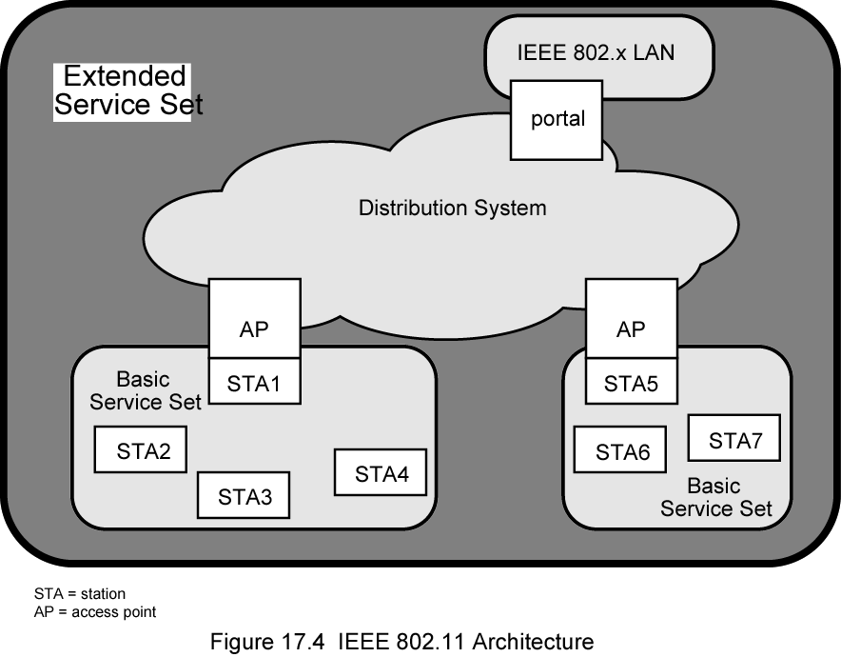
IEEE 802.11 Architecture

Slide 26
Services
Service | Provider | Category
Association | Distribution system | MSDU delivery
Authentication | Station | LAN access and security
Deauthentication | Station | LAN access and security
Dissassociation | Distribution system | MSDU delivery
Distribution | Distribution system | MSDU delivery
Integration | Distribution system | MSDU delivery
MSDU delivery | Station | MSDU delivery
Privacy | Station | LAN access and security
Reassocation | Distribution system | MSDU delivery

Slide 27
Categorizing Services
Station services implemented in every 802.11 station
Including AP stations
Distribution services provided between BSSs
May be implemented in AP or special-purpose device
Three services used to control access and confidentiality
Six services used to support delivery of MAC service data units (MSDUs) between stations
Block of data passed down from MAC user to MAC layer
Typically LLC PDU
If MSDU too large for MAC frame, fragment and transmit in series of frames (see later)

Slide 28
Distribution of Messages Within a DS
Distribution is primary service used by stations to exchange MAC frames when frame must traverse DS
From station in one BSS to station in another BSS
Transport of message through DS is beyond scope of 802.11
If stations within same BSS, distribution service logically goes through single AP of that BSS
Integration service enables transfer of data between station on 802.11 LAN and one on an integrated 802.x LAN
Integrated refers to wired LAN physically connected to DS
Stations may be logically connected to 802.11 LAN via integration service
Integration service takes care of address translation and media conversion

Slide 29
Association Related Services
Purpose of MAC layer transfer MSDUs between MAC entities
Fulfilled by distribution service (DS)
DS requires information about stations within ESS
Provided by association-related services
Station must be associated before communicating
Three transition types of based on mobility
No transition: Stationary or moves within range of single BSS
BSS transition: From one BSS to another within same ESS
Requires addressing capability be able to recognize new location
ESS transition: From BSS in one ESS to BSS in another ESS
Only supported in sense that the station can move
Maintenance of upper-layer connections not guaranteed
Disruption of service likely

Slide 30
Station Location
DS needs to know where destination station is
Identity of AP to which message should be delivered
Station must maintain association with AP within current BSS
Three services relate to this requirement:
Association: Establishes initial association between station and AP
To make identity and address known
Station must establish association with AP within particular BSS
AP then communicates information to other APs within ESS
Reassociation: Transfer established association to another AP
Allows station to move from one BSS to another
Disassociation: From either station or AP that association is terminated
Given before station leaves ESS or shuts
MAC management facility protects itself against stations that disappear without notification

Slide 31
Access and Privacy Services - Authentication
On wireless LAN, any station within radio range other devices can transmit
Any station within radio range can receive
Authentication: Used to establish identity of stations to each other
Wired LANs assume access to physical connection conveys authority to connect to LAN
Not valid assumption for wireless LANs
Connectivity achieved by having properly tuned antenna
Authentication service used to establish station identity
802.11 supports several authentication schemes
Allows expansion of these schemes
Does not mandate any particular scheme
Range from relatively insecure handshaking to public-key encryption schemes
802.11 requires mutually acceptable, successful authentication before association

Slide 32
Access and Privacy Services - Deauthentication and Privacy
Deauthentication: Invoked whenever an existing authentication is to be terminated
Privacy: Used to prevent messages being read by others
802.11 provides for optional use of encryption

Slide 33
Medium Access Control
MAC layer covers three functional areas
Reliable data delivery
Access control
Security
Beyond our scope

Slide 34
Reliable Data Delivery
802.11 physical and MAC layers subject to unreliability
Noise, interference, and other propagation effects result in loss of frames
Even with error-correction codes, frames may not successfully be received
Can be dealt with at a higher layer, such as TCP
However, retransmission timers at higher layers typically order of seconds
More efficient to deal with errors at the MAC level
802.11 includes frame exchange protocol
Station receiving frame returns acknowledgment (ACK) frame
Exchange treated as atomic unit
Not interrupted by any other station
If noACK within short period of time, retransmit

Slide 35
Four Frame Exchange
Basic data transfer involves exchange of two frames
To further enhance reliability, four-frame exchange may be used
Source issues a Request to Send (RTS) frame to destination
Destination responds with Clear to Send (CTS)
After receiving CTS, source transmits data
Destination responds with ACK
RTS alerts all stations within range of source that exchange is under way
CTS alerts all stations within range of destination
Stations refrain from transmission to avoid collision
RTS/CTS exchange is required function of MAC but may be disabled

Slide 36
Media Access Control
Distributed wireless foundation MAC (DWFMAC)
Distributed access control mechanism
Optional centralized control on top
Lower sublayer is distributed coordination function (DCF)
Contention algorithm to provide access to all traffic
Asynchronous traffic
Point coordination function (PCF)
Centralized MAC algorithm
Contention free
Built on top of DCF

Slide 37
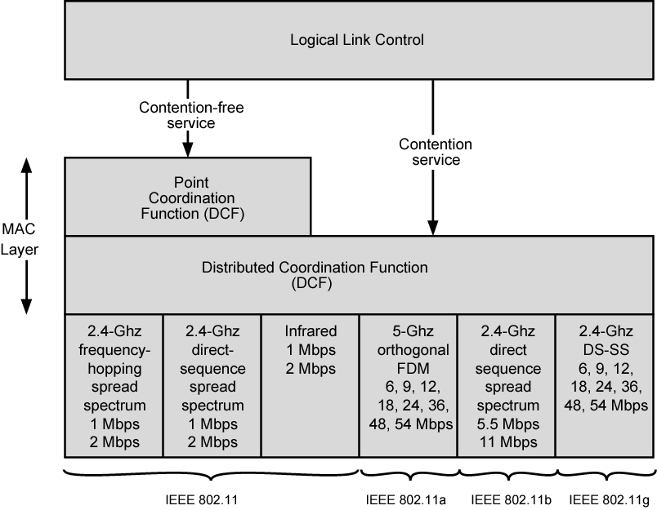
IEEE 802.11 Protocol Architecture

Slide 38
Distributed Coordination Function
DCF sublayer uses CSMA
If station has frame to transmit, it listens to medium
If medium idle, station may transmit
Otherwise must wait until current transmission complete
No collision detection
Not practical on wireless network
Dynamic range of signals very large
Transmitting station cannot distinguish incoming weak signals from noise and effects of own transmission
DCF includes delays
Amounts to priority scheme
Interframe space

Slide 39
Interframe Space
Single delay known as interframe space (IFS)
Using IFS, rules for CSMA:
Station with frame senses medium
If idle, wait to see if remains idle for one IFS. If so, may transmit immediately
If busy (either initially or becomes busy during IFS) station defers transmission
Continue to monitor until current transmission is over
Once current transmission over, delay another IFS
If remains idle, back off random time and again sense
If medium still idle, station may transmit
During backoff time, if becomes busy, backoff timer is halted and resumes when medium becomes idle
To ensure stability, binary exponential backoff used

Slide 40
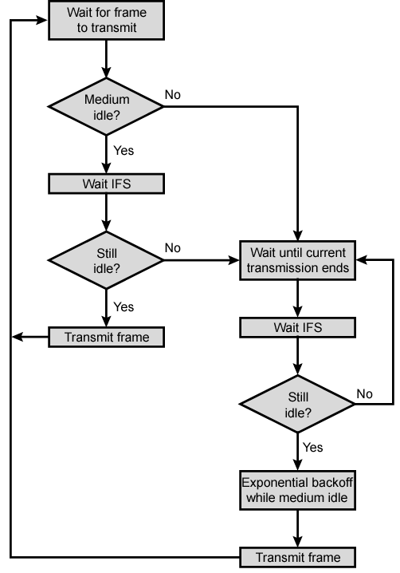
IEEE 802.11 Medium Access Control Logic

Slide 41
Priority
Use three values for IFS
SIFS (short IFS):
Shortest IFS
For all immediate response actions (see later)
PIFS (point coordination function IFS):
Midlength IFS
Used by the centralized controller in PCF scheme when issuing polls
DIFS (distributed coordination function IFS):
Longest IFS
Used as minimum delay for asynchronous frames contending for access

Slide 42
SIFS Use - ACK
Station using SIFS to determine transmission opportunity has highest priority
In preference to station waiting PIFS or DIFS time
SIFS used in following circumstances:
Acknowledgment (ACK): Station responds with ACK after waiting SIFS gap
No collision detection so likelihood of collisions greater than CSMA/CD
MAC-level ACK gives efficient collision recovery
SIFS provide efficient delivery of multiple frame LLC PDU
Station with multiframe LLC PDU to transmit sends out MAC frames one at a time
Each frame acknowledged after SIFS by recipient
When source receives ACK, immediately (after SIFS) sends next frame in sequence
Once station has contended for channel, it maintains control of all fragments sent

Slide 43
SIFS Use – CTS
Clear to Send (CTS): Station can ensure data frame will get through by issuing RTS
Destination station should immediately respond with CTS if ready to receive
All other stations hear RTS and defer
Poll response: See Point coordination Function (PCF)

Slide 44
PIFS and DIFS
PIFS used by centralized controller
Issuing polls
Takes precedence over normal contention traffic
Frames using SIFS have precedence over PCF poll
DIFS used for all ordinary asynchronous traffic

Slide 45
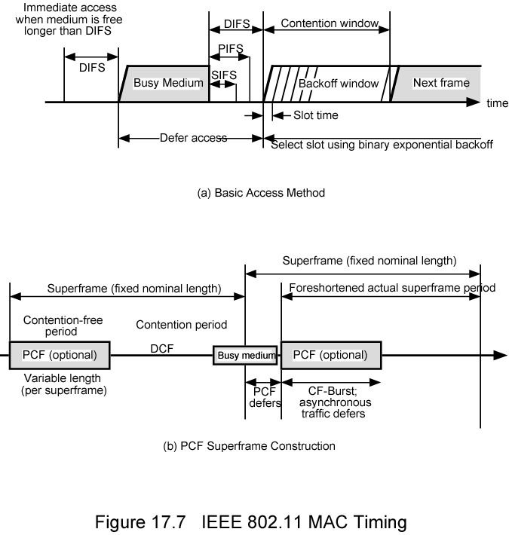
IEEE 802.11 MAC Timing Basic Access Method

Slide 46
Point Coordination Function (PCF)
Alternative access method implemented on top of DCF
Polling by centralized polling master (point coordinator)
Uses PIFS when issuing polls
PIFS smaller than DIFS
Can seize medium and lock out all asynchronous traffic while it issues polls and receives responses
E.g. wireless network configured so number of stations with time-sensitive traffic controlled by point coordinator
Remaining traffic contends for access using CSMA
Point coordinator polls in round-robin to stations configured for polling
When poll issued, polled station may respond using SIFS
If point coordinator receives response, it issues another poll using PIFS
If no response during expected turnaround time, coordinator issues poll

Slide 47
Superframe
Point coordinator would lock out asynchronous traffic by issuing polls
Superframe interval defined
During first part of superframe interval, point coordinator polls round-robin to all stations configured for polling
Point coordinator then idles for remainder of superframe
Allowing contention period for asynchronous access
At beginning of superframe, point coordinator may seize control and issue polls for given period
Time varies because of variable frame size issued by responding stations
Rest of superframe available for contention-based access
At end of superframe interval, point coordinator contends for access using PIFS
If idle, point coordinator gains immediate access
Full superframe period follows
If busy, point coordinator must wait for idle to gain access
Results in foreshortened superframe period for next cycle

Slide 48
IEEE 802.11 MAC Timing PCF Superframe Construction

Slide 49
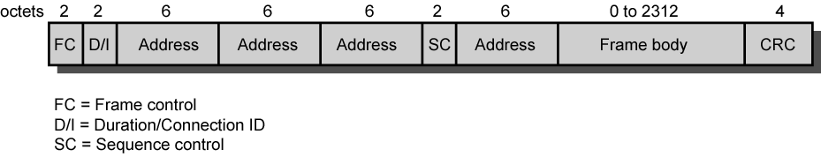
IEEE 802.11 MAC Frame Format

Slide 50
MAC Frame Fields (1)
Frame Control:
Type of frame
Control, management, or data
Provides control information
Includes whether frame is to or from DS, fragmentation information, and privacy information
Duration/Connection ID:
If used as duration field, indicates time (in μs) channel will be allocated for successful transmission of MAC frame
In some control frames, contains association or connection identifier
Addresses:
Number and meaning of address fields depend on context
Types include source, destination, transmitting station, and receiving station

Slide 51
MAC Frame Fields (2)
Sequence Control:
4-bit fragment number subfield
For fragmentation and reassembly
12-bit sequence number
Number frames between given transmitter and receiver
Frame Body:
MSDU (or a fragment of)
LLC PDU or MAC control information
Frame Check Sequence:
32-bit cyclic redundancy check

Slide 52
Control Frames
Assist in reliable data delivery
Power Save-Poll (PS-Poll)
Sent by any station to station that includes AP
Request AP transmit frame buffered for this station while station in power-saving mode
Request to Send (RTS)
First frame in four-way frame exchange
Clear to Send (CTS)
Second frame in four-way exchange
Acknowledgment (ACK)
Contention-Free (CF)-end
Announces end of contention-free period part of PCF
CF-End + CF-Ack:
Acknowledges CF-end
Ends contention-free period and releases stations from associated restrictions

Slide 53
Data Frames – Data Carrying
Eight data frame subtypes, in two groups
First four carry upper-level data from source station to destination station
Data
Simplest data frame
May be used in contention or contention-free period
Data + CF-Ack
Only sent during contention-free period
Carries data and acknowledges previously received data
Data + CF-Poll
Used by point coordinator to deliver data
Also to request station send data frame it may have buffered
Data + CF-Ack + CF-Poll
Combines Data + CF-Ack and Data + CF-Poll

Slide 54
Data Frames – Not Data Carrying
Remaining four data frames do not carry user data
Null Function
Carries no data, polls, or acknowledgments
Carries power management bit in frame control field to AP
Indicates station is changing to low-power state
Other three frames (CF-Ack, CF-Poll, CF-Ack + CF-Poll) same as corresponding frame in preceding list (Data + CF-Ack, Data + CF-Poll, Data + CF-Ack + CF-Poll) but without data

Slide 55
Management Frames
Used to manage communications between stations and Aps
E.g. management of associations
Requests, response, reassociation, dissociation, and authentication

Slide 56
802.11 Physical Layer
Issued in four stages
First part in 1997
IEEE 802.11
Includes MAC layer and three physical layer specifications
Two in 2.4-GHz band and one infrared
All operating at 1 and 2 Mbps
Two additional parts in 1999
IEEE 802.11a
5-GHz band up to 54 Mbps
IEEE 802.11b
2.4-GHz band at 5.5 and 11 Mbps
Most recent in 2002
IEEE 802.g extends IEEE 802.11b to higher data rates

Slide 57
Original 802.11 Physical Layer - DSSS
Three physical media
Direct-sequence spread spectrum
2.4 GHz ISM band at 1 Mbps and 2 Mbps
Up to seven channels, each 1 Mbps or 2 Mbps, can be used
Depends on bandwidth allocated by various national regulations
13 in most European countries
One in Japan
Each channel bandwidth 5 MHz
Encoding scheme DBPSK for 1-Mbps and DQPSK for 2-Mbps

Slide 58
Original 802.11 Physical Layer - FHSS
Frequency-hopping spread spectrum
2.4 GHz ISM band at 1 Mbps and 2 Mbps
Uses multiple channels
Signal hopping from one channel to another based on a pseudonoise sequence
1-MHz channels are used
23 channels in Japan
70 in USA
Hopping scheme adjustable
E.g. Minimum hop rate forUSA is 2.5 hops per second
Minimum hop distance 6 MHz in North America and most of Europe and 5 MHz in Japan
Two-level Gaussian FSK modulation for 1-Mbps
Bits encoded as deviations from current carrier frequency
For 2 Mbps, four-level GFSK used
Four different deviations from center frequency define four 2-bit combinations

Slide 59
Original 802.11 Physical Layer – Infrared
Omnidirectional
Range up to 20 m
1 Mbps used 16-PPM (pulse position modulation)
Each group of 4 data bits mapped into one of 16-PPM symbols
Each symbol a string of 16 bits
Each 16-bit string consists of fifteen 0s and one binary 1
For 2-Mbps, each group of 2 data bits is mapped into one of four 4-bit sequences
Each sequence consists of three 0s and one binary 1
Intensity modulation
Presence of signal corresponds to 1

Slide 60
802.11a
5-GHz band
Uses orthogonal frequency division multiplexing (OFDM)
Not spread spectrum
Also called multicarrier modulation
Multiple carrier signals at different frequencies
Some bits on each channel
Similar to FDM but all subchannels dedicated to single source
Data rates 6, 9, 12, 18, 24, 36, 48, and 54 Mbps
Up to 52 subcarriers modulated using BPSK, QPSK, 16-QAM, or 64-QAM
Depending on rate
Subcarrier frequency spacing 0.3125 MHz
Convolutional code at rate of 1/2, 2/3, or 3/4 provides forward error correction

Slide 61
802.11b
Extension of 802.11 DS-SS scheme
5.5 and 11 Mbps
Chipping rate 11 MHz
Same as original DS-SS scheme
Same occupied bandwidth
Complementary code keying (CCK) modulation to achieve higher data rate in same bandwidth at same chipping rate
CCK modulation complex
Overview on next slide
Input data treated in blocks of 8 bits at 1.375 MHz
8 bits/symbol × 1.375 MHz = 11 Mbps
Six of these bits mapped into one of 64 code sequences
Output of mapping, plus two additional bits, forms input to QPSK modulator

Slide 62
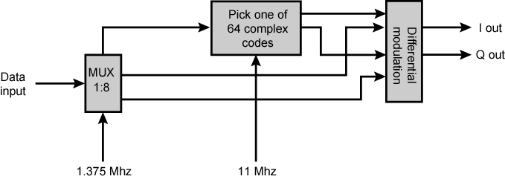
11-Mbps CCK Modulation Scheme

Slide 63
802.11g
Higher-speed extension to 802.11b
Combines physical layer encoding techniques used in 802.11a and 802.11b to provide service at a variety of data rates

Slide 64
Required Reading
Stallings chapter 17
Web sites on 802.11

